Slide 1
Sustainable Development

Slide 2
Definition
Economic development that is conducted without depletion of Natural resources.

Slide 3
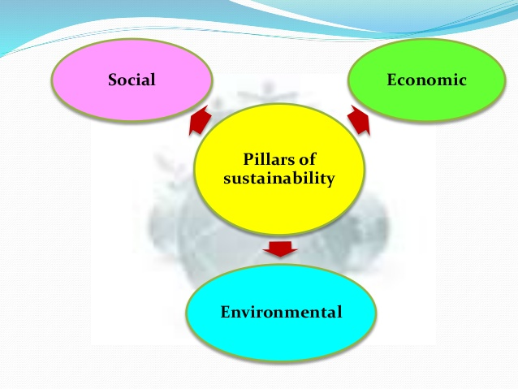

Slide 4
Sustainability principles
Reduce dependence upon fossil fuel, underground metals and minerals.
Reduce dependence upon synthetic chemicals and other unnatural substances.
Reduce encroachment upon nature.
Meet human needs fairly & efficiently.

Slide 5
Features
Sustained rise in real per capita income and economic welfare.
Rational use of Natural resources.
No reduction in the ability of future generations to meet their own words.
Pollution control

Slide 6
Strategies of Sustainable Development
No reduction in the ability of future generations to meet their own words. and
Pollution control
Sustained rise in real per capita income and economic welfare.
Utilize solar power
1
3
5
7
Use wind mills
Use LPG & Gobar gas in rural areas
Use nonconventional sources of energy like Solar, wind, Hydro & Biomass
Rational use of Natural resources.
2
4
6
8

Slide 7
Green Computing
Green computing is the environmentally responsible use of computers, reducing their environmental impact throughout their life cycle.
Green Design : Designing energy efficient computers, printers, projectors and other digital devices.
Green Manufacturing : Minimizing waste during the manufacturing of computers.
Green use : Minimizing the electricity consumption of computers and their peripheral devices and using them in an eco-friendly manner.
Green disposal: Re-purposing an existing computer or appropriately disposing of or recycling, unwanted electronic equipment.

Slide 8
Organic Farming
Organic farming does not use chemical fertilizers and chemical pesticides.
Organic farming is based on following principles:
Nature is the best role model for farming since it uses neither chemicals nor poisons and does not demand excessive water.
Soil is a living system and not an inert bowl for dumping chemicals.
Soil’s living populations of microbes and other organisms are significant contributors to its fertility on a sustained basis and must be protected and numerated at all costs.
The total environment of the soil-from soil structure to soil cover is more important than any nutrients we may wish to pump into it.

Slide 9
Desired Outcomes of sustainable development
Clean water & air.
Fertile soil & good food.
A livelihood & a healthy economy.
An optimum population size.
Halting global warming.
Safety from poverty & disease.
Social contact & a sense of community.
Work, rest & celebration.
Opportunities to learn.

Slide 10
Thank you

